Slide 1

TO NETAJI SUBHASH INSTITUTE OF TECHNOLOGY
Amhara BIHTA 801106

Slide 2


Presented by
Sachinkumar
MDasif
Aman kumar
Faizal

Slide 3

What is digital India
Flagship government of india programme launched on 1 july 2015
Vision;-transform India int a digitally empowered society and knowledge economy
Focus;-digital infrastructure,services on demand ,and citizen empowernment
Ket idea ;- build interoperable digital system that can scale nationally

Slide 4

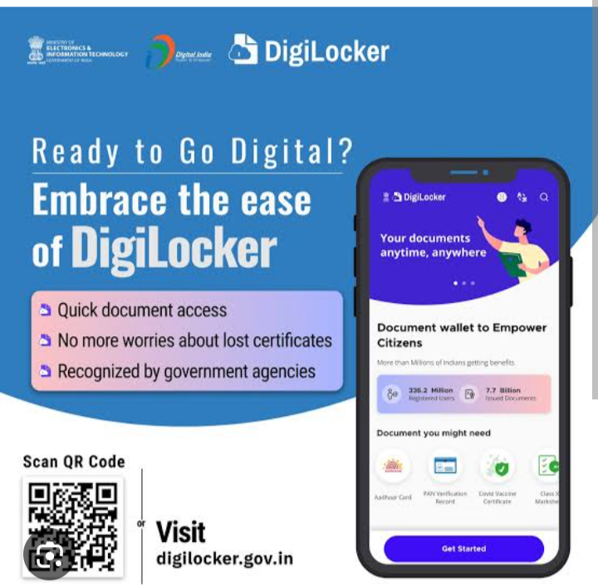

Digital public infrastructure
Aadhaar;-digital identity layer
UpI;-interoperable real-time payment
Digilocker;-trusted digital document layer
E-kyc/sign/aips;- reusable service rails
ONDC and open networks- interoperability beyond a single platform

Slide 5
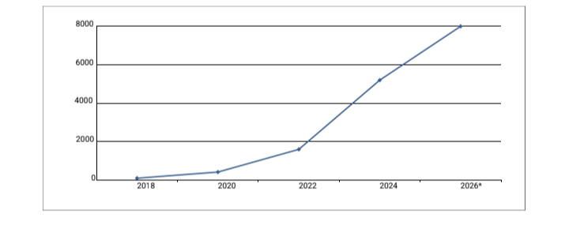
UPI;A scale payment rail

Slide 6
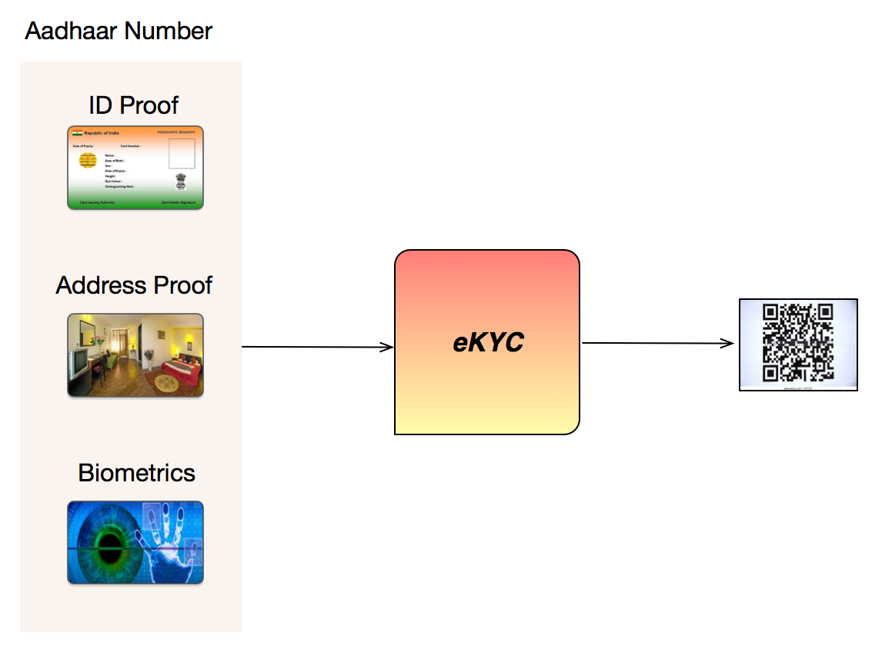
Aadhaar + e-KYC: Digital Identity Layer
Provides a widely used digital identity infrastructure
. e-KYC can reduce repetitive paper-based verification in supported services
. Useful when identity, authentication and service delivery need to work together.
Strong governance is essential: purpose limitation, security, consent and grievance mechanisms.

Slide 7
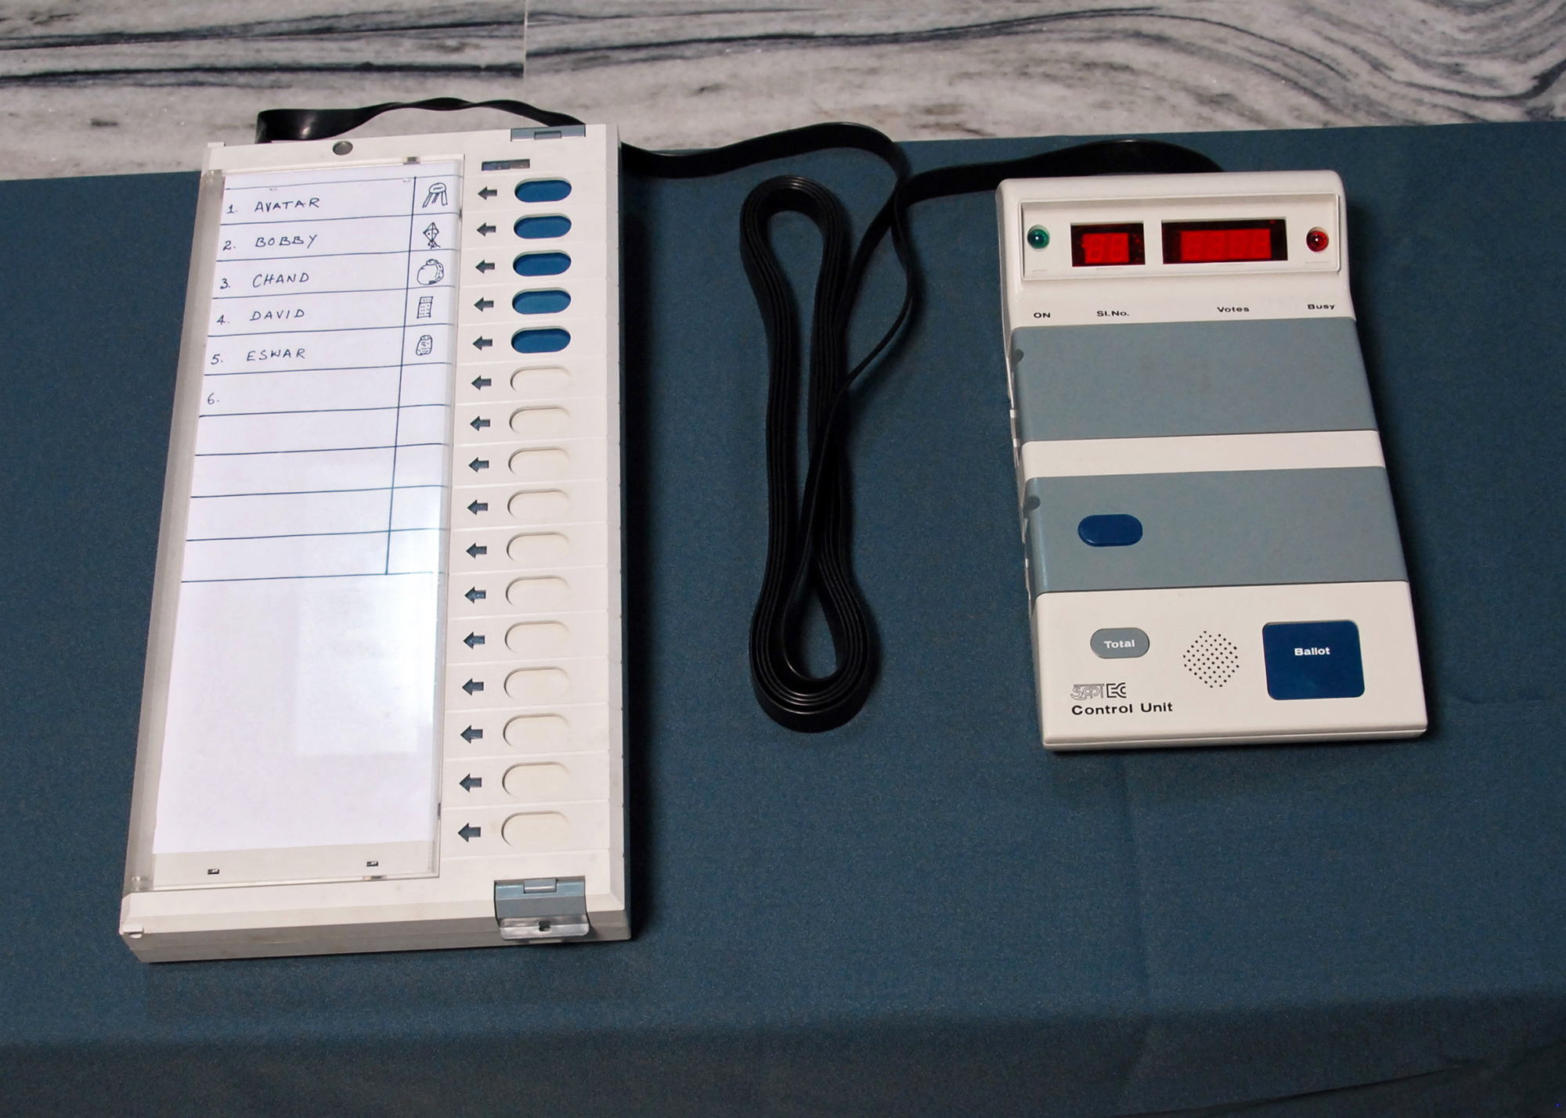
Digilocker & paperless governance
Digital repository and sharing platform for authentic documents
Can reduce physical paperwork and verification friction.
Usefuel example; educational certificates,driving licence and other isuued records
Interoperability lets institution verify documents digitally where supported

Slide 8

Cybersecurity, privacy& trust
Threats; phishing,account takeover ,malware data leakage and social engineering
Security must be designed into identity , payment and sevices layers
Principles; least privillage,encryption ,strong aythentician ,monitoring and incident response.
Privacy ;collect only what is needed, ptotect it and provide transparency and user rights

Slide 9
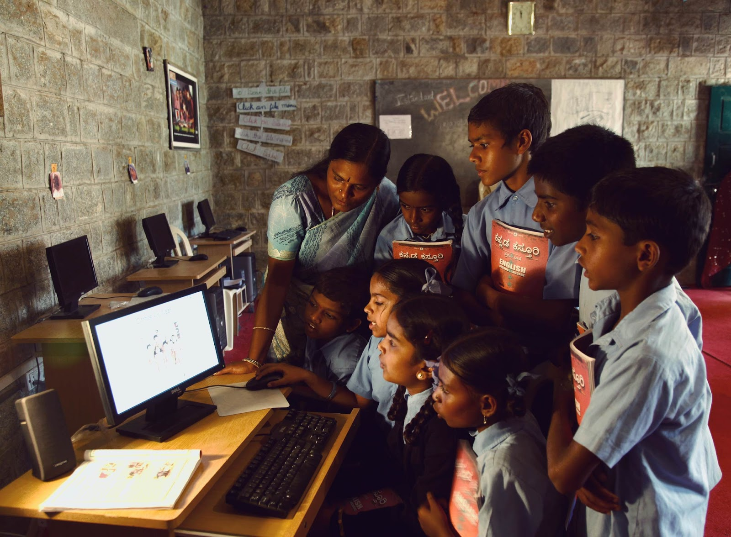
DIGITAL INDIA IN RURAL AREA
Online learning and digital content expand access beyond physical classroom
Digital public service can reduce travel and paperworks for citizen
Rural inclusion depend connectivity ,affordablity devices local-language content and digital literacy.
Accessibility and assistedfor citizens who need support

Slide 10
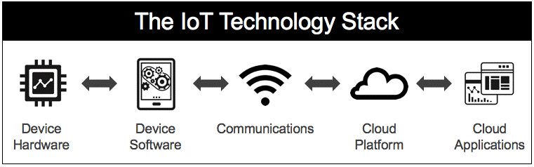
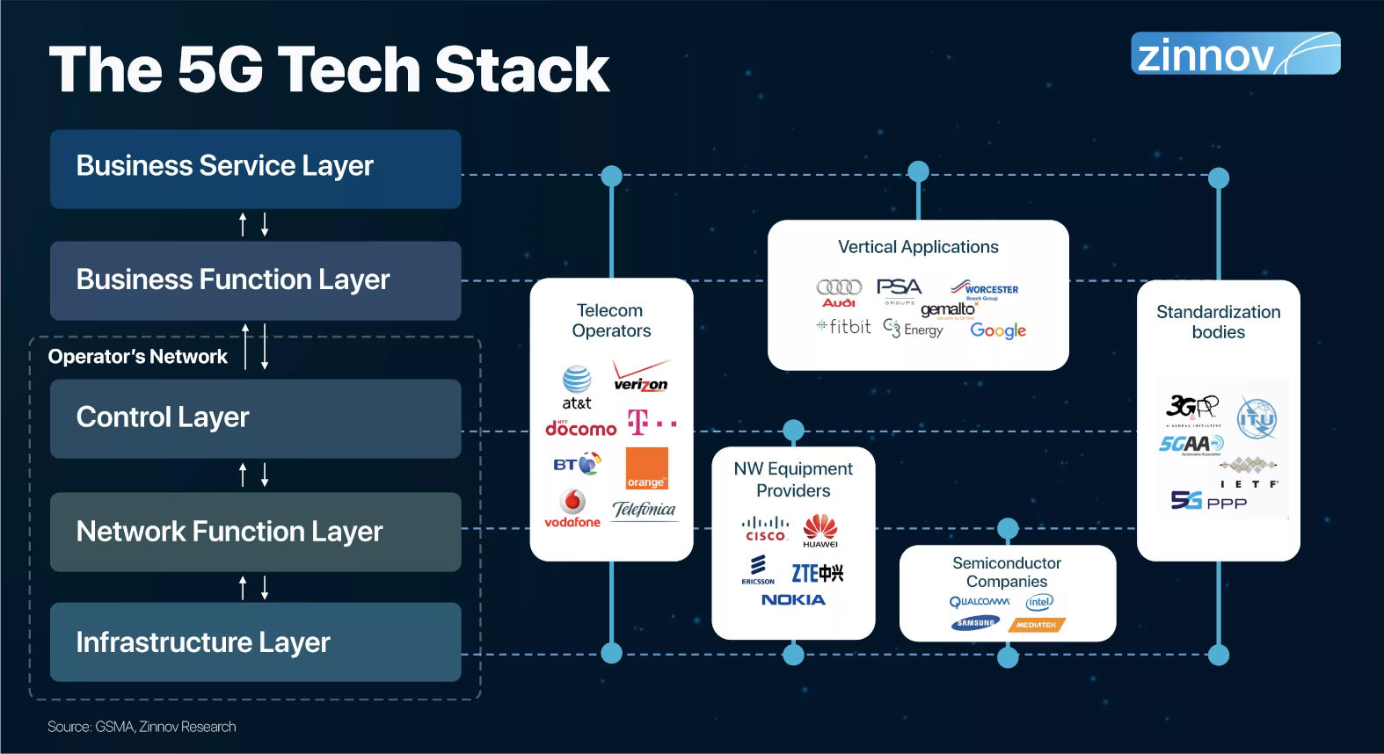

Technology stack Behind DIgital India
Connectivity;4G/5G, fibre broadband networks
Platforms;-cloud infrstructure databases and scalable Apis
Security;-encyption, authentication.fraud detection and monitoring
Intelligence;-analytics andAi for automation and decision support
Interoperability;- common standardthat let different systems communicate
.

Slide 11
Challenges & Future Scope
Close the digital divide across geography, income, language and accessibility
. Strengthen cybersecurity and privacy-by-design. Improve digital literacy and awareness against online fraud
. Expand reliable connectivity and resilient public digital infrastructure
. Future: AI-enabled public services, stronger digital credentials and more open, interoperable

Slide 12
. Conclusion
Digital India is more than digitising paperwork— it is about building reusable digital infrastructure.
Interoperability, scale and low-friction access are central to its impact.
Long-term success depends on inclusion, security, privacy and trust.

Slide 13


